Slide 1
Discrete Event Simulator
IN710 OOSD 2013
Major Project

Slide 2
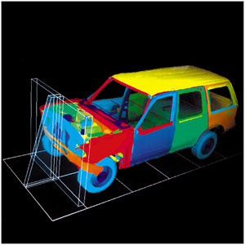
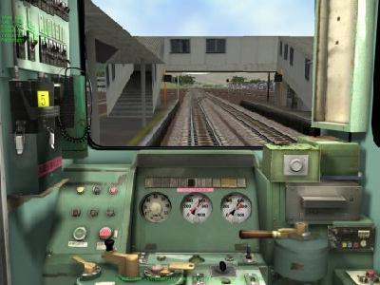
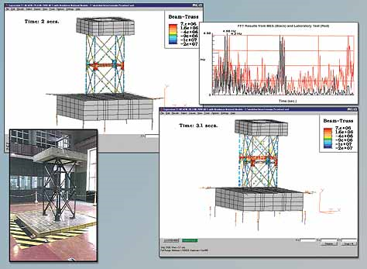
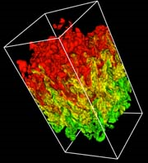
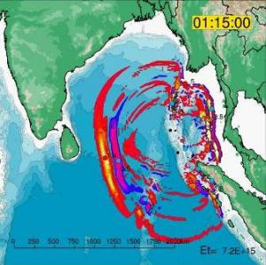
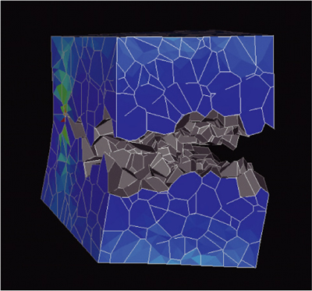
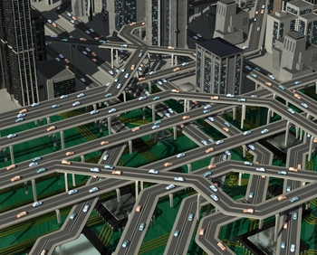
Simulation
Crash impact
Driver Training
Earthquake
Supernova fluid dynamics
Tsunami
Stress corrosion in nuclear reactor
Traffic Flow
Notes:
We’re not talking here about purely visual simulations – “artists conception of the new stadium”. We’re talking about computational simulations, where the dynamics and behaviour of a complex system is represented as a set of computations by the machine.
By modifying the parameters of those computations, we can explore various “what if” scenarios about the behaviour/performance of the represented system.
We are going to build one of the most straightforward kinds of simulators – a discrete event simulator
In these systems there is no heavy maths, simply a description of the behaviour of an event-driven system
We model the system and observe its state (using whatever measures we care about) over time

Slide 3
Review of Main Components
Notes:
We will present first general examples, and then specifically from the call centre.

Slide 4
Entities
Actors in the system
Customers at the post office
Animals in simulated habitat
Packets on a network
Products on assembly line
Calls to a call centre
Notes:
Since we are writing OO, we will of course be modelling entities as objects
In our specific system, our entities will be calls to a call centre

Slide 5
Attributes
Properties of the entities that determine behaviour
Customer’s planned task
Age of animal
Packet destination
Type of call – car stereo or other
Notes:
Again, since we are writing OO, we will be modelling attributes as object data members and properties

Slide 6
Events
Things that affect entities, and cause a change in the system state
Post office customer gets in line
Animal is born
Product assembly is completed
Call Centre Events
Call arrives
Call goes to switchboard (delay)
Call put on hold (queue)
Call reaches representative
Call is finished
Notes:
Events vs Activities can be confusing. Basically, events are things that happen and activities are things that consume time. So an Event can usually be seen as the start of an activity.
Note the difference between delay events – things that just take some nonzero amount of time – and queue events – things that depend on competition for a resource.
These two kinds of events are modelled differently
A delay event just lasts for some probabilistically determined amount of time; the time for a queue event depends on the amount of competition for the resource at that moment.
We will also be modelling events as objects.
We will have a “calendar” which is a collection of future events each storing the time they are going to occur
We work through the calendar, processing each event by observing/computing/displaying its impact on all the entities in the system

Slide 7
Resources
Anything used/required/needed/desired by entities, that has a limited capacity
Bank tellers
Food
Bandwidth
Sales Representatives
Notes:
And, of course, we will model resources as objects
You can envision one instance for each representative in our model system.
We will have to think carefully about the different way we model entities, which are basically passive things that sit around waiting for events to happen to them, and the way we model resources, which are more active, being part of what determines when events occur

Slide 8
State Variables – 1
Values that represent the fixed configuration of the system
Number of post office workers
Habitat area
Number of lathes
Call Centre
Number of sales reps
Maximum calls that can be on hold
Notes:
Two kinds

Slide 9
State Variables – 2
Values that represent the changing state of the system
Number of customers in line
Distribution of animal ages
Amount of available food
Number of partially assembled products
Call Centre
Number of calls on hold for each type of representative
Notes:
Two kinds

Slide 10
System Parameters
Values (usually probabilistic) that determine the dynamic behaviour of the system
Rate of customer arrival
Probability of animal reproduction
Distribution of assembly time
Call centre: Time to process a call.

Slide 11
System Parameters
Call Centre
Time required for a representative to process a call
Notes:
Modelled as “roll of two dice”. What’s the algorithm? (rand(6) +1 + rand(6) + 1)
These values are all probabilistic.
That is, they have an element of random variation, just like they would in the real world
So, we don’t say: “It takes exactly 3 minutes to process a call”.
That would not be realistic
Instead, we make a distribution of process times, that is like the real world
For this project, we are using a “normal” distribution, like this one
Each time we want to decide how long it takes to process the current call, we essentially randomly select a number from this distribution
Most of the time, we will get something around 6 or 7 minutes, but occasionally, we will get 11, or 2. This is quite realistic
Using this technique, we can make a very realistic model of reality.
For example, what if the above is realistic for the Other product queue, but we know that the car stereo calls always take longer. We just use a different distribution to assign processing times to the two kinds of calls.
Like this:

Slide 12
System Parameters
Call Centre
Time required for a car stereo representative to process a call
Time required for an “other product” representative to process a call
Interval between incoming calls
Delay time at the switchboard
Distribution of call type (car stereo vs. other)
Notes:
Here are all the system parameters

Slide 13
System Statistics
Values collected during a simulation to describe the behaviour/performance of the system
Total animal population
Time for packet to reach destination
Number of products assembled
Notes:
These can be whatever will help you find out what you want to know about your system

Slide 14
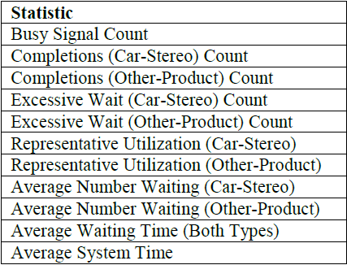
System Statistics
Call Centre
Notes:
These can be whatever will help you find out what you want to know about your system
As described in the paper, these are the values we will collect and compute
Your client wants to know how many reps are needed to avoid lots of hang ups and long waits, so we need to determine these things

Slide 15
The Calendar
A list of all events that are scheduled in the future
Stored in order of time of execution
At each cycle, the system:
Removes the first event in the calendar
Updates the global “clock” to that event’s execution time
Processes the event
Updates system stats if required

Slide 16
The Calendar
Processing an event usually:
Changes the state of the entity
Changes the state of the system
May spawn new event(s) for the calendar
May spawn a new entity
Notes:
Changes the state of the entity
For example, the event might be “finishing at the switchboard”. This would change the state of the entity to being in a queue or talking to a sales rep
Changes the state of the system
For example, moving an entity into a queue changes the length of the queue
Spawns new events for the calendar
Moving an entity to a sales rep spawns a “finishes talking to rep” event in the future
Generating a new call adds an “incoming call” event in the future
May spawn one or more new entities
When a new call arrival event is put into the calendar

Slide 17
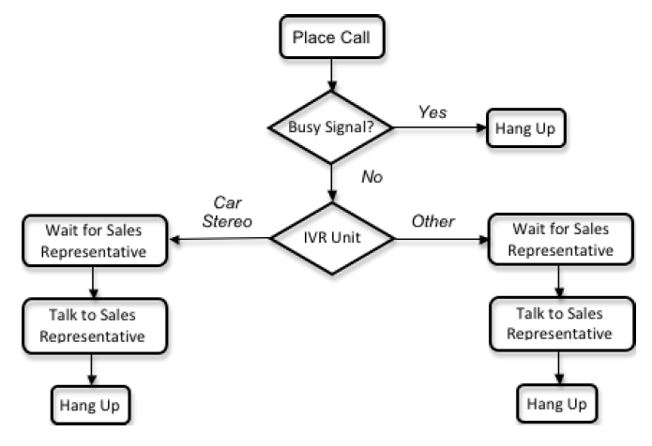
The Call Centre
Notes:
Logically, the system works like this (talk through)
Note that as the problem is defined, we don’t need a queue for the IVR (the switchboard)
When you get to the switchboard, it takes some normally distributed amount of time to get your call routed, but the switchboard handles an infinite number of calls at the same time.

Slide 18
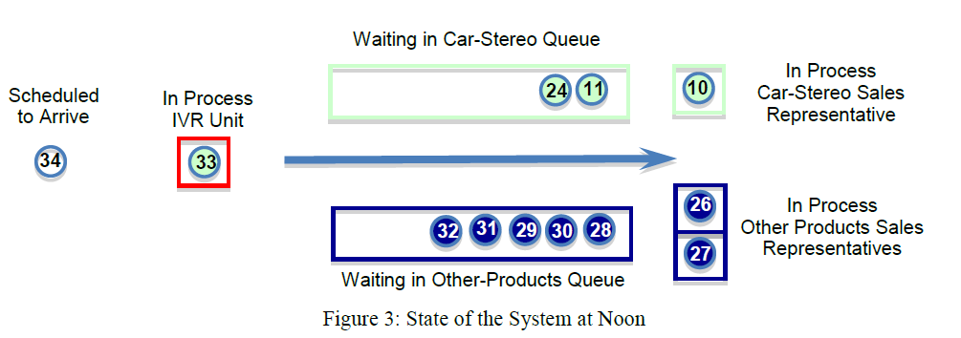
The Simulation Process
Notes:
Graphically, we envision the system state like this.
And for your project, you will need to make a graphical representation of some kind
But computationally, to perform the simulation, you keep track of the state of the calendar and of the two queues
Each cycle is the fetching and dealing with of the top event on the calendar
Let’s step through a couple of cycles

Slide 19
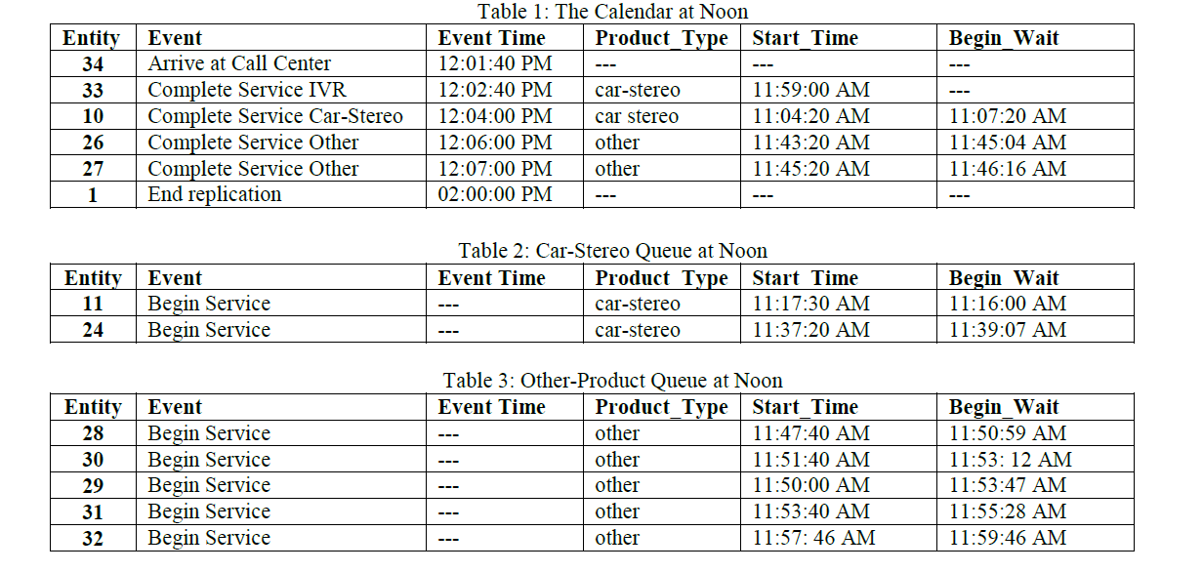
The Simulation Process
Notes:
Here is the example from the article
This shows the calendar and queues corresponding to the graphical representation on the previous slide
Let’s consider what happens next:

Slide 20
The Simulation Process
To process the Arrive at Call Centre event
Update the clock to 12:01:40
Event 34 becomes the active entity
Set its start time to 12:01:40
Set its Product_Type (stochastically)
Count number waiting in the queues
If too many, “hang up”
If not too many
Compute the wait time at the switch (stochastically)
Return entity 34 to the calendar with a “Complete Switchboard” event
Compute the next arrival interval for entity 35
Add that Arrive at Call Centre event to the calendar
Notes:
The cycle begins with the fetching (and removal) of the next scheduled event
We handle the event.
Update the clock. Note that the hours:minutes thing is unnecessary. Just count the minutes is fine
Set its start time – the time it entered the system, which is now
In the paper, they set the type at this time as well. In my solution, I set the type when I create the event and put it in the calendar queue. That is an implementation you will need to think through.
If you hang up, just do nothing. The entity is done
Otherwise, you are going to pass this entity onto the switch. So compute the time for that to happen and put a new event on the calendar.
The two new events generated : ArriveAtCallCenter for entity 35, and CompleteSwitchboard for entity 34 can go anywhere in the calendar. It depends on the times computed for them. If 34 rolled a long wait at the switch, he can move well down the event list; if 35 rolled a long interval, he can be after events already in the queue

Slide 21
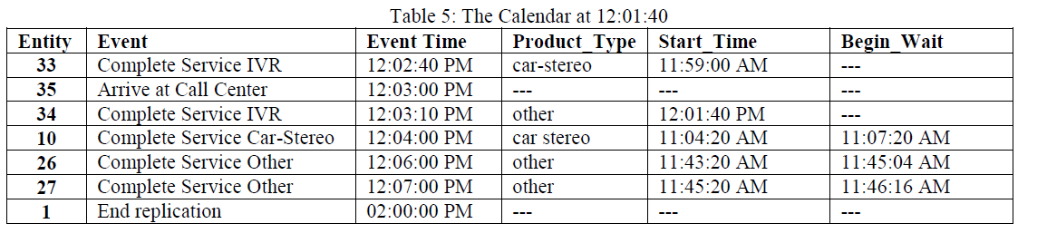
The Simulation Process
Notes:
In the example in the paper, 34’s completion time turns out to be 12:03:10, and 35’s arrival time 12:03:00. Both of those are later than the guy currently sitting at the head of the event queue (entity 33, who will complete switchboard at 12:02:40), so the resulting state of the queue is this.
Observe that you will need sorting….
So next, we process the complete switchboard event for 33

Slide 22
The Simulation Process
To process the Complete Switchboard event
Update the clock to 12:02:40
Entity 33 is the Active Entity
Entity 33 is a Car Stereo call
The Car Stereo sales representative is busy so Entity 33 goes into the Car Stereo queue
Entity 33’s BeginWaitTime is set to 12:02:40
In this case, no new events were added to the calendar
Notes:
In the example in the paper, 34’s completion time turns out to be 12:03:10, and 35’s arrival time 12:03:00. Both of those are later than the guy currently sitting at the head of the event queue (entity 33, who will complete switchboard at 12:02:40), so the resulting state of the queue is this.
So next, we process the complete switchboard event for 33
And so on.

Slide 23
The Simulation Process
To process a Complete Service event
Update clock
Update stats, as this entity is leaving the system
The sales rep is now free, so
Look in the corresponding queue
If empty
Set sales rep to not busy
else
Remove entity at head of queue
Compute its time to process
Add a new Complete Service event to the calendar at that time, with that entity
Notes:
Recall that when an entity finishes at the switchboard, we check to see if all his reps are busy, so we must save that state
And so on.
You need to work out the actions to take for each kind of event, and handle them.

Slide 24
Architecture Idea
Simulator
Simulator
Bunch of fields……
Bunch of properties…
Bunch of methods…..
public void RunSimulation()
{
….
}
Notes:
If you were to look at my solution, you would see this class...

Slide 25
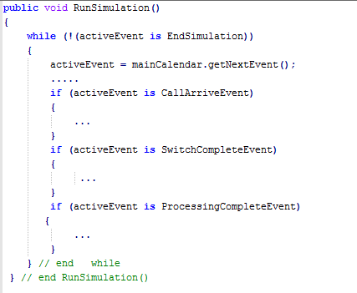
Architecture Idea
Notes:
And if you looked at that run method, it would look like this...
The ellipses are lots of lines of code, but the global structure is very simple
What is the “is” operator doing? => checking for the type of the activeEvent object.
So CallArriveEvent, SwitchCompleteEvent, etc. must be types.
What do you think these types all have in common? ➔ They are all descended from the base type Event.

Slide 26
Random Number Generation
Notes:
Remember this?
This describes the probability distribution for rolling two dice…

Slide 27
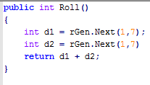
Random Number Generation
Assume an object with a Random called rGen
Notes:
We agreed that we could easily code it up like this.
So…
How then would you produce the CarStereo distribution, which was the same shape, but distributed from 4 to 24?
roll() * 2
The call interval in the paper is normally distributed between 2/3 of a minute and 4 minutes. How do you compute that?
roll() * .33
And so on

Slide 28
Next....
What classes do I need?
What data members do they need?
What methods do they need?

Slide 29




Next
Are any of the Design Patterns useful here?
Will any of the .NET data structures help me here?
How about delegates or events?
Do I need a database?
How about threads?

